Slide 1
MACHINE LEARNING PROJECT
Professor:- Murali Shankar
PRESENTED BY: NIKHIL REDDY ADDULA

Slide 2
PROBLEM STATEMENT
TO DEFINE AND LOCATE CLUSTERS USING ALL VARIABLES.
PERFORMING THE CLUSTERS USING K-MEANS.
INTERPRETING CLUSTER DATA.
WHAT CLUSTERS ARE FORMED BASED ON THE ALGORITHM USED.
CLUSTERS HAVE MINIMAL AND HIGH FUEL COST
CLUSTERS HAVE THE HIGHEST ASH AND SULFUR OUTPUT
MOST OPTIMAL CLUSTER

Slide 3
DATA DESCRIPTION
* ANALYSING THE VARIABLES IN THE DATA SET
* CLEANING THE DATA SET
* PERFORMING THE SAMPLE FRACTION BY 2%
* PARTITIONING THE SAMPLED FRACTION BY 75%
* NORMALIZING DATA USING SCALE
* TO UNDERSTAND THE POWER GENERATION IN THE US, I HAVE SELECTED A FEW VARIABLES.

Slide 4
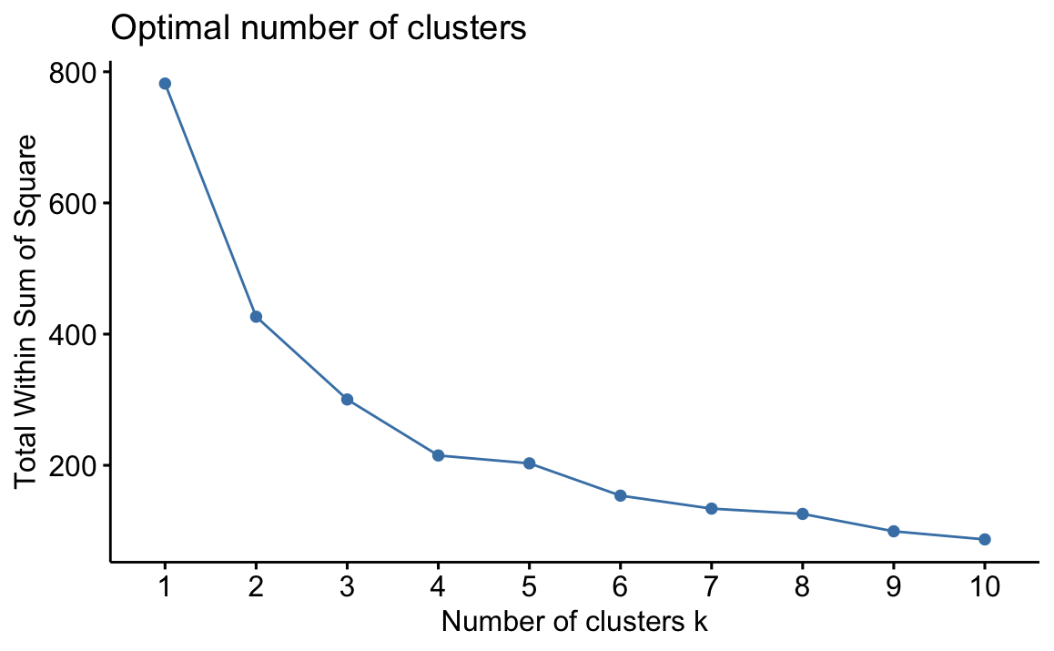
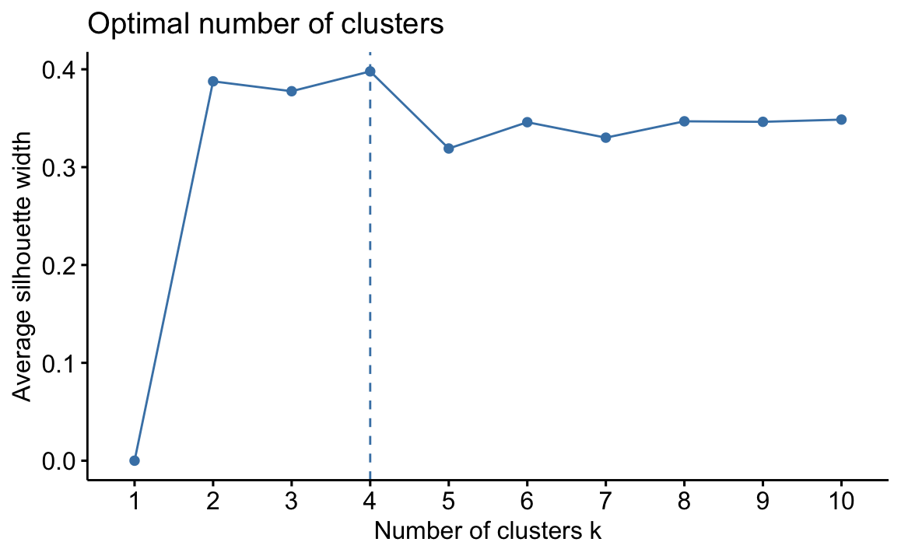
ANALYSIS
*AS THE PART OF ANALYSIS PERFORMED K MEANS TO OBTAIN THE CENTERS
*K MEANS DEALS BEST WAY WITH LARGE DATA
* K MEANS IS USED AND 4 CLUSTERS OBTAINED
WSS Method
Silhouette Method

Slide 5
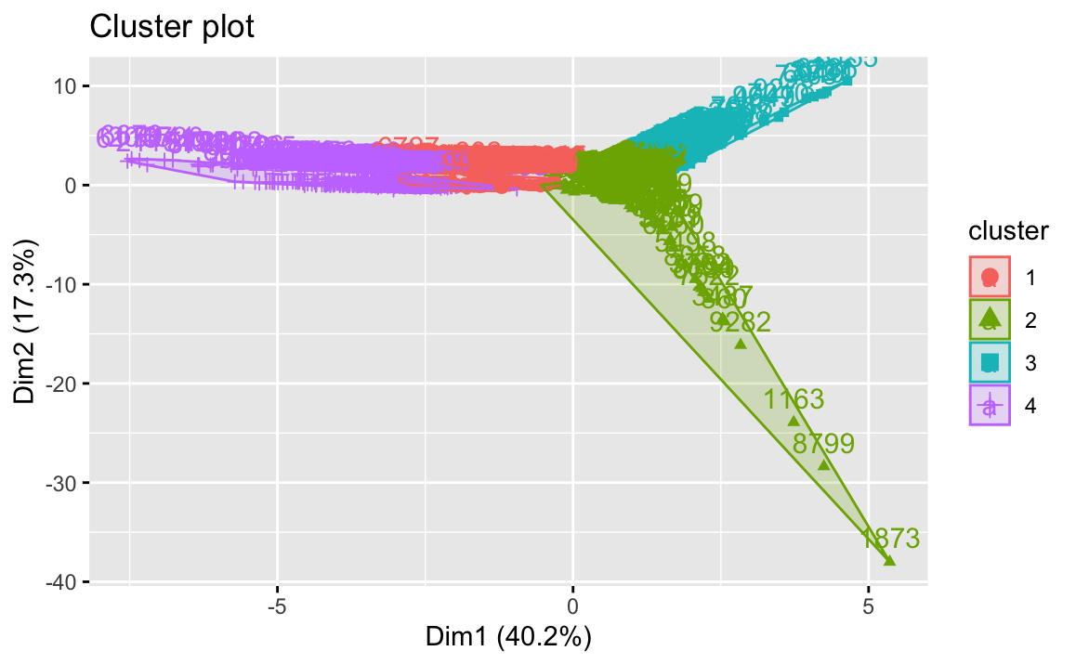
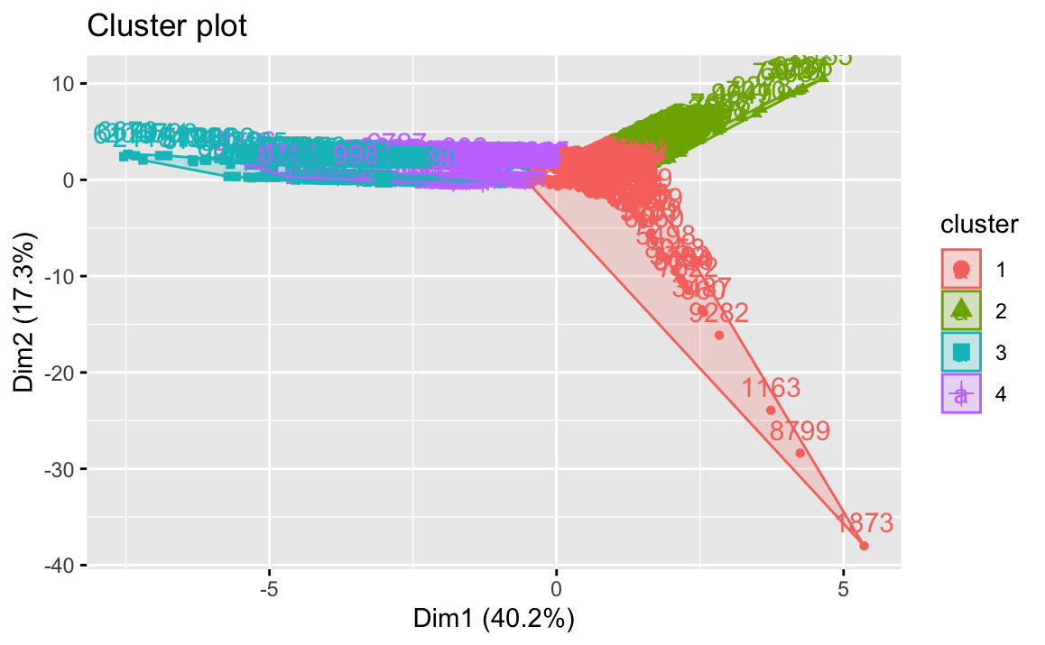
WSS
SILHOUETTE

Slide 6
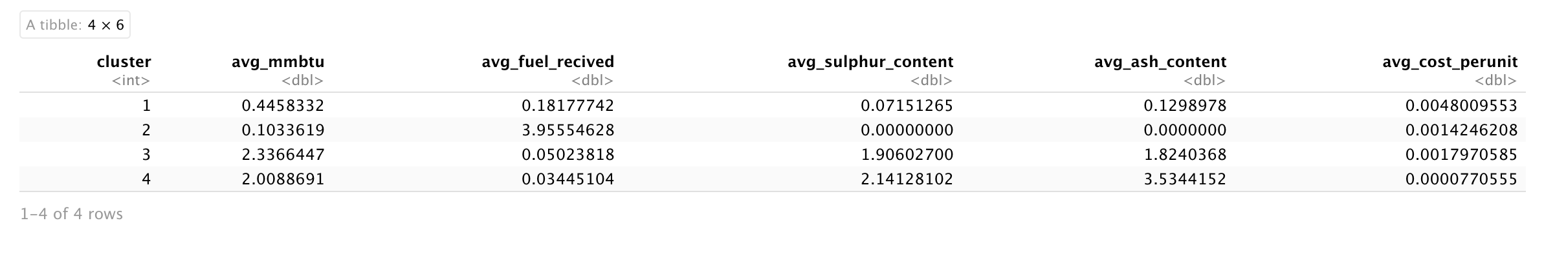
ANALYSIS

Slide 7
CONCLUSION & DISCUSSION
BY SUMMARIZING THE DATA SET THAT IS GIVEN I HAVE FOUND THAT K=4 IS THE BEST VALUE FOR THE DATA SET AND FORMED THE CLUSTERS .
BASED ON MY ANALYSIS CLUSTER 4 IS THE BEST CLUSTER BECAUSE THE ASH AND SULPHER CONTENT IS MINIMAL AND HAS AVG_MMBTU WHICH (HEAT) IS MORE.

